Slide 1
Pipeline for organizing Project 5 COVID CDEs by their semantic meaning instructions
April 07, 2023
Samvit Solutions

Slide 2
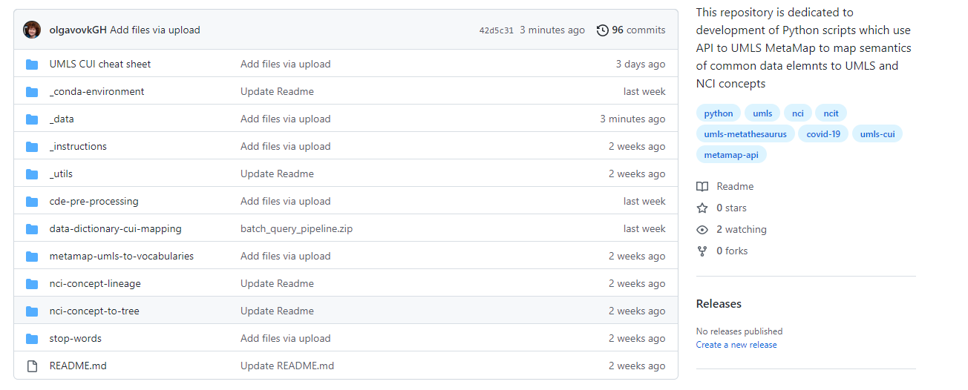
Proof of Concept Python Pipeline on CBIIT GitHub
The latest and greatest Python scripts are available on CBIIT/UMLS-MetaMap-API-Scripts GitHub
COVID CDE mappings and tree
Pipeline: Python scripts

Slide 3
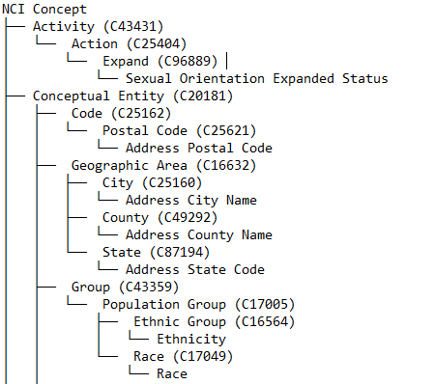

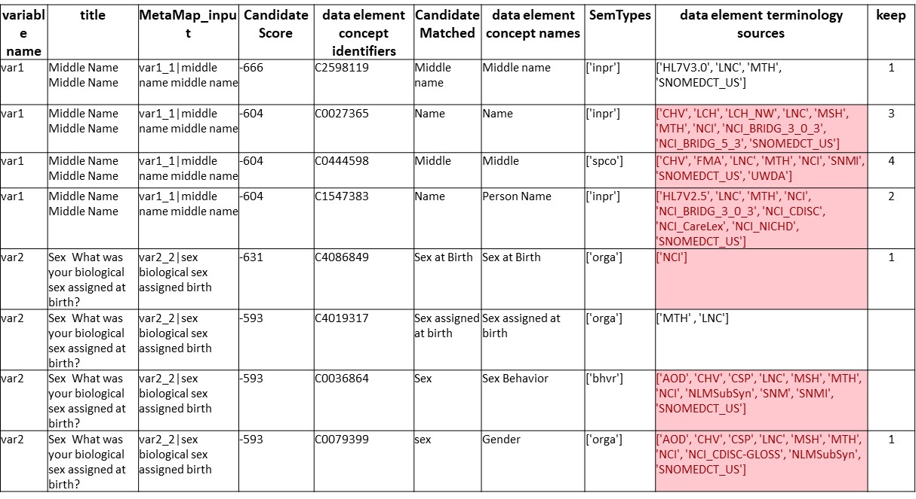

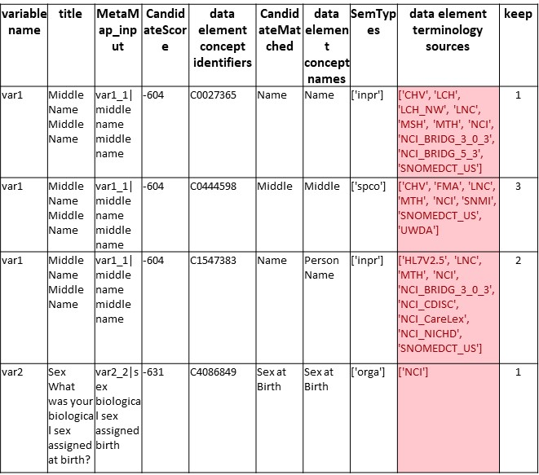

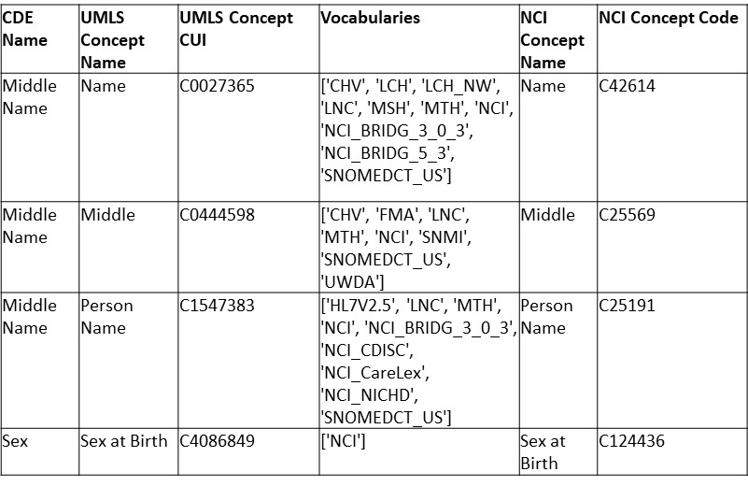







Pipeline architecture
CDEs presented
in the NCIt tree
MetaMap
MetaMap
output file
retrieves CUIs
Submits an excel
File with data
elements
Candidates
Submit to MetaMap
Python script
Researcher
File prepared for
MetaMap
Python script
Curated MetaMap
Output file
Python Script
NCIt Excel
download
Uses UMLS CUIs & Retrieves corresponding NCIt Codes
UMLS Metathesaurus

Slide 4
CDE attributes to UMLS CUIs -> NCI CUIs -> NCI Concept Tree
Input: Project 5 COVID CDE 2 attributes: CDE Name and Question text
Python
MS Excel Formula
Curation
Curation
Curation
API to MetaMap scripts
UMLS to NCIt script
NCIt concept lineage retrieval from EVS
Python
NCI concept lineage tree

Slide 5
Software and hardware requirements
The Python scripts were developed and tested using:
Python 3.9
Anaconda Navigator (Anaconda 3)
Python modules needed to run the scripts include:
Pandas; Numpy; OS; treelib; Tree(from treelib); pathlib; Path(from Path); shutil; glob; tkinter; filedialog(from tkinter); json; pprint; openpyxl; requests.
Anaconda environment: download the environment files to use in Anaconda, to make your life easier.
To use the MetaMap Python API requires to build on your local the Python-based API created for the Indexing Initiative Scheduler facility (NLM) used to provide users with the ability to programmatically submit jobs to the Scheduler Batch and Interactive facilities.
Hardware:
The scripts were tested on standard NIH Dell laptops. (nothing special)
Other requirements:
Have an access the UMLS: request a UMLS Metathesaurus License and API key

Slide 6
Proof of concept - Python pipeline on CBIIT GitHub
0. Pre-processing step: addressing the issue that all CDE repositories have slightly different templates
From Project 5 COVID CDE spreadsheet take 2 columns: CDE Name and Question Text. Save as a CSV.
Run through cde-pre-processing.py
Save the output as a CSV file
1. API to MetaMap set of scripts (batch_query_pipeline.py ): load in a data dictionary and map CDE semantics to UMLS CUIs using MetaMap API from NLM
Set up the configuration file (can be done once)
Specifically enter user name and API key (can be done once)
Take the output from step #0c, run through batch_query_pipeline.py
Review the output, select the UMLS CUIs best match CDE semantics
Format and save the output as .xls file
2. UMLS to NCIt (umls-to-vocabularies.py): returning NCIt CUIs for UMLS CUIs
Take the output from the step #1e.
Run thorough umls-to-vocabularies.py
Save the output as a CSV file
3. Retrieve NCIt concept lineage
Take the output from #2c and
Apply the MS Excel formula from “NCIt concept lineage retrieval from EVS file.xlsx”
Save the output file as a CSV file.
4. Build NCIt concept tree for each CDE (nci-concept-to-tree.py )
Take an output from 3c
Run through nci-concept-to-tree.py
Review and save the output as a TXT file

Slide 7





Proof of concept Python pipeline on CBIIT GitHub
0
cde-pre-processing.zip – transforms 2 column CSV file with Project 5 COVID CDE attributes: “CDE Name” and “Question Text” to feed to MetaMap. This step can be omitted
batch_query_pipeline.zip – API to MetaMap set of scripts, created and supported by BRICS. The main GitHub for developing these scripts is Kevin A. GitHub repository. The package allows to load in a data dictionary and map CDE semantics to UMLS CUIs using MetaMap API from NLM
umls-to-vocabularies.py – the script which hits API to UMLS and returns NCIt concept for each given UMLS concept for each CDE
nci-concept-lineage – contains “NCIt concept lineage retrieval form EVS file.xlsx” file which uses a formula applied to December 2022 NCI Thesaurus download from EVS
nci-concept-to-tree.zip - generates a tree like structure (as a TXT file) where NCIt concepts and CUIs are presented as branches and common data elements as leaves
1
2
3
4
CBIIT GitHub: https://github.com/CBIIT/UMLS-MetaMap-API-Scripts

Slide 8
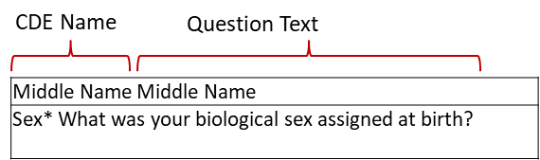
Process outline: API to MetaMap to map CDE attributes to UMLS CUIs (batch_query_pipeline.py)
For each CDEs from Project 5 COVID CDEs spreadsheet batch_query_pipeline.py script:
Takes a CSV file with CDE attributes from step #0
Removes stop words and punctuation marks. Stop words on GitHub.
Saves the CDE attributes file in tab delimited format, where each row represents a single CDE.
Runs the file from #3 through API to MetaMap using the settings,
specified in “config_metamap_api.yml” file (next slide).
5. Outputs the MetaMap mapping as an MS Excel file (next slide).
batch_query_pipeline.py
var1_1|middle name middle name
var2_2|sex biological sex assigned birth

Slide 9
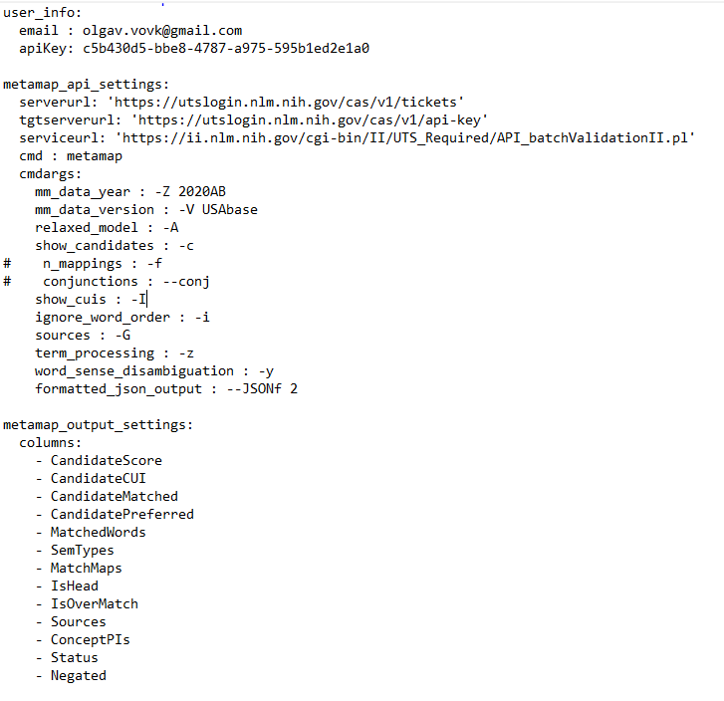
Process outline: API to MetaMap to map CDE attributes to UMLS CUIs (configuration file)
Use config_metamap_api.yml to configure
1. Access to UMLS Metathesaurus
2. MetaMap API settings
3. MetaMap output settings
This can be done once.
config_metamap_api.yaml
MetaMap FAQ https://lhncbc.nlm.nih.gov/ii/tools/MetaMap/Docs/MM_FAQ.pdf
https://lhncbc.nlm.nih.gov/ii/tools/MetaMap/Docs/MM12_XML_Info.html

Slide 10
Process outline: manually review MetaMap output
Use this column to select which concepts to keep for mapping
Manually review MetaMap output.
variable name | title | MetaMap_input | Candidate Score | data element concept identifiers | CandidateMatched | data element concept names | SemTypes | data element terminology sources (‘NCI’ highlighted in red) | keep
var1 | Middle Name Middle Name | var1_1|middle name middle name | -666 | C2598119 | Middle name | Middle name | ['inpr'] | ['HL7V3.0', 'LNC', 'MTH', 'SNOMEDCT_US'] | 1
var1 | Middle Name Middle Name | var1_1|middle name middle name | -604 | C0027365 | Name | Name | ['inpr'] | ['CHV', 'LCH', 'LCH_NW', 'LNC', 'MSH', 'MTH', 'NCI', 'NCI_BRIDG_3_0_3', 'NCI_BRIDG_5_3', 'SNOMEDCT_US'] | 3
var1 | Middle Name Middle Name | var1_1|middle name middle name | -604 | C0444598 | Middle | Middle | ['spco'] | ['CHV', 'FMA', 'LNC', 'MTH', 'NCI', 'SNMI', 'SNOMEDCT_US', 'UWDA'] | 4
var1 | Middle Name Middle Name | var1_1|middle name middle name | -604 | C1547383 | Name | Person Name | ['inpr'] | ['HL7V2.5', 'LNC', 'MTH', 'NCI', 'NCI_BRIDG_3_0_3', 'NCI_CDISC', 'NCI_CareLex', 'NCI_NICHD', 'SNOMEDCT_US'] | 2
var2 | Sex What was your biological sex assigned at birth? | var2_2|sex biological sex assigned birth | -631 | C4086849 | Sex at Birth | Sex at Birth | ['orga'] | ['NCI'] | 1
var2 | Sex What was your biological sex assigned at birth? | var2_2|sex biological sex assigned birth | -593 | C4019317 | Sex assigned at birth | Sex assigned at birth | ['orga'] | ['MTH' , 'LNC']
var2 | Sex What was your biological sex assigned at birth? | var2_2|sex biological sex assigned birth | -593 | C0036864 | Sex | Sex Behavior | ['bhvr'] | ['AOD', 'CHV', 'CSP', 'LNC', 'MSH', 'MTH', 'NCI', 'NLMSubSyn', 'SNM', 'SNMI', 'SNOMEDCT_US']
var2 | Sex What was your biological sex assigned at birth? | var2_2|sex biological sex assigned birth | -593 | C0079399 | sex | Gender | ['orga'] | ['AOD', 'CHV', 'CSP', 'LNC', 'MSH', 'MTH', 'NCI', 'NCI_CDISC-GLOSS', 'NLMSubSyn', 'SNOMEDCT_US'] | 1
When reviewing the list of concepts, consider checking with project concepts’ “cheat sheet”. Available on GitHub.
Structure of MetaMap’s JSON output: https://lhncbc.nlm.nih.gov/ii/tools/MetaMap/Docs/JSON.pdf
UMLS Semantic types cheat sheet https://lhncbc.nlm.nih.gov/ii/tools/MetaMap/Docs/SemanticTypes_2018AB.txt

Slide 11
Process outline: save curated MetaMap output
Saving curated MetaMap output in a format so it can be fed to UMLS to Vocabularies script
Curated MetaMap output file, .xls
Table_1.xls file to be used by umls-to-vocabularies.py
variable name | title | MetaMap_input | CandidateScore | data element concept identifiers | CandidateMatched | data element concept names | SemTypes | data element terminology sources | keep
var1 | Middle Name Middle Name | var1_1|middle name middle name | -604 | C0027365 | Name | Name | ['inpr'] | ['CHV', 'LCH', 'LCH_NW', 'LNC', 'MSH', 'MTH', 'NCI', 'NCI_BRIDG_3_0_3', 'NCI_BRIDG_5_3', 'SNOMEDCT_US'] | 1
var1 | Middle Name Middle Name | var1_1|middle name middle name | -604 | C0444598 | Middle | Middle | ['spco'] | ['CHV', 'FMA', 'LNC', 'MTH', 'NCI', 'SNMI', 'SNOMEDCT_US', 'UWDA'] | 3
var1 | Middle Name Middle Name | var1_1|middle name middle name | -604 | C1547383 | Name | Person Name | ['inpr'] | ['HL7V2.5', 'LNC', 'MTH', 'NCI', 'NCI_BRIDG_3_0_3', 'NCI_CDISC', 'NCI_CareLex', 'NCI_NICHD', 'SNOMEDCT_US'] | 2
var2 | Sex What was your biological sex assigned at birth? | var2_2|sex biological sex assigned birth | -631 | C4086849 | Sex at Birth | Sex at Birth | ['orga'] | ['NCI'] | 1
CDE Name | UMLS Concept Name | UMLS Concept CUI | Vocabularies
Middle Name | Name | C0027365 | ['CHV', 'LCH', 'LCH_NW', 'LNC', 'MSH', 'MTH', 'NCI', 'NCI_BRIDG_3_0_3', 'NCI_BRIDG_5_3', 'SNOMEDCT_US']
Middle Name | Middle | C0444598 | ['CHV', 'FMA', 'LNC', 'MTH', 'NCI', 'SNMI', 'SNOMEDCT_US', 'UWDA']
Middle Name | Person Name | C1547383 | ['HL7V2.5', 'LNC', 'MTH', 'NCI', 'NCI_BRIDG_3_0_3', 'NCI_CDISC', 'NCI_CareLex', 'NCI_NICHD', 'SNOMEDCT_US']
Sex | Sex at Birth | C4086849 | ['NCI']

Slide 12
Process outline: API to MetaMap - notes
Note: to restrict MetaMap to return only those UMLS concepts which are present in NCI vocabularies, one can use the settings defined in config_metamap_api.yaml file for batch_query_pipeline.py and specify: “restrict to sources: -R, NCI”
(work in progress).
Note: to address the issue that different CDE repositories have slightly different CDE templates, one can specify the list of columns in a given template in de.yaml configuration file (work in progress).
Note: one can also specify which CDE attributes (or columns in the CDE spreadsheet) use for mapping in de.yaml configuration file (work in progress).
MetaMap’s Exclude and Restrict to UMLS Sources: https://lhncbc.nlm.nih.gov/ii/tools/MetaMap/Docs/Sources.pdf

Slide 13
Process outline: UMLS to NCIt
umls-to-vocabularies.py – the script which hits the UMLS API and returns NCIt concept for each given UMLS concept for each CDE.
We have moved now from UMLS to NCIt.
Input: Table_1.xls file
Output: Final_Table.csv file
CDE Name | UMLS Concept Name | UMLS Concept CUI | Vocabularies
Middle Name | Name | C0027365 | ['CHV', 'LCH', 'LCH_NW', 'LNC', 'MSH', 'MTH', 'NCI', 'NCI_BRIDG_3_0_3', 'NCI_BRIDG_5_3', 'SNOMEDCT_US']
Middle Name | Middle | C0444598 | ['CHV', 'FMA', 'LNC', 'MTH', 'NCI', 'SNMI', 'SNOMEDCT_US', 'UWDA']
Middle Name | Person Name | C1547383 | ['HL7V2.5', 'LNC', 'MTH', 'NCI', 'NCI_BRIDG_3_0_3', 'NCI_CDISC', 'NCI_CareLex', 'NCI_NICHD', 'SNOMEDCT_US']
Sex | Sex at Birth | C4086849 | ['NCI']
CDE Name | UMLS Concept Name | UMLS Concept CUI | Vocabularies | NCI Concept Name | NCI Concept Code
Middle Name | Name | C0027365 | ['CHV', 'LCH', 'LCH_NW', 'LNC', 'MSH', 'MTH', 'NCI', 'NCI_BRIDG_3_0_3', 'NCI_BRIDG_5_3', 'SNOMEDCT_US'] | Name | C42614
Middle Name | Middle | C0444598 | ['CHV', 'FMA', 'LNC', 'MTH', 'NCI', 'SNMI', 'SNOMEDCT_US', 'UWDA'] | Middle | C25569
Middle Name | Person Name | C1547383 | ['HL7V2.5', 'LNC', 'MTH', 'NCI', 'NCI_BRIDG_3_0_3', 'NCI_CDISC', 'NCI_CareLex', 'NCI_NICHD', 'SNOMEDCT_US'] | Person Name | C25191
Sex | Sex at Birth | C4086849 | ['NCI'] | Sex at Birth | C124436

Slide 14
Process outline: for each CDE retrieve NCIt concept lineage
nci-concept-lineage – contains “NCIt concept lineage retrieval from EVS file.xlsx” file which uses a lookup formula to identify a parent-child hierarchy from root to leaf.
(Note: the formula was applied to December 2022 NCI Thesaurus download from EVS. NCI publishes the updated version every month. Each NCI concept can have multiple parents, the formula picks the first parent.)
Output from umls-to-vocabularies.py: Final_Table.csv file
MS Excel formula
CDE Name | UMLS Concept Name | UMLS Concept CUI | Vocabularies | NCI Concept Name | NCI Concept Code | NCIt Concept Lineage
Middle Name | Name | C0027365 | ['CHV', 'LCH', 'LCH_NW', 'LNC', 'MSH', 'MTH', 'NCI', 'NCI_BRIDG_3_0_3', 'NCI_BRIDG_5_3', 'SNOMEDCT_US'] | Name | C42614 | Conceptual Entity (C20181) > Name (C42614)
Middle Name | Middle | C0444598 | ['CHV', 'FMA', 'LNC', 'MTH', 'NCI', 'SNMI', 'SNOMEDCT_US', 'UWDA'] | Middle | C25569 | Property or Attribute (C20189) > Qualifier (C41009) > Spatial Qualifier (C73706) > Middle (C25569)
Middle Name | Person Name | C1547383 | ['HL7V2.5', 'LNC', 'MTH', 'NCI', 'NCI_BRIDG_3_0_3', 'NCI_CDISC', 'NCI_CareLex', 'NCI_NICHD', 'SNOMEDCT_US'] | Person Name | C25191 | Conceptual Entity (C20181) > Name (C42614) > Person Name (C25191)
Sex | Sex at Birth | C4086849 | ['NCI'] | Sex at Birth | C124436 | Property or Attribute (C20189) > Person/Individual Attribute (C171087) > Personal Attribute (C19332) > Sex (C28421) > Sex at Birth (C124436)
NCIt EVS downloads: https://evs.nci.nih.gov/ftp1/

Slide 15
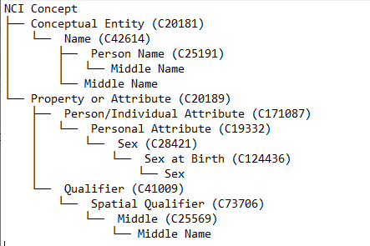
Process outline: build NCIt concept tree for each CDE
nci-concept-to-tree.py - generates a tree like structure (as a TXT file) from the output file from step 3, where NCIt concepts and CUIs are presented as branches and common data elements as leaves
Middle Name CDE
Sex CDE
Middle Name CDE

Slide 16
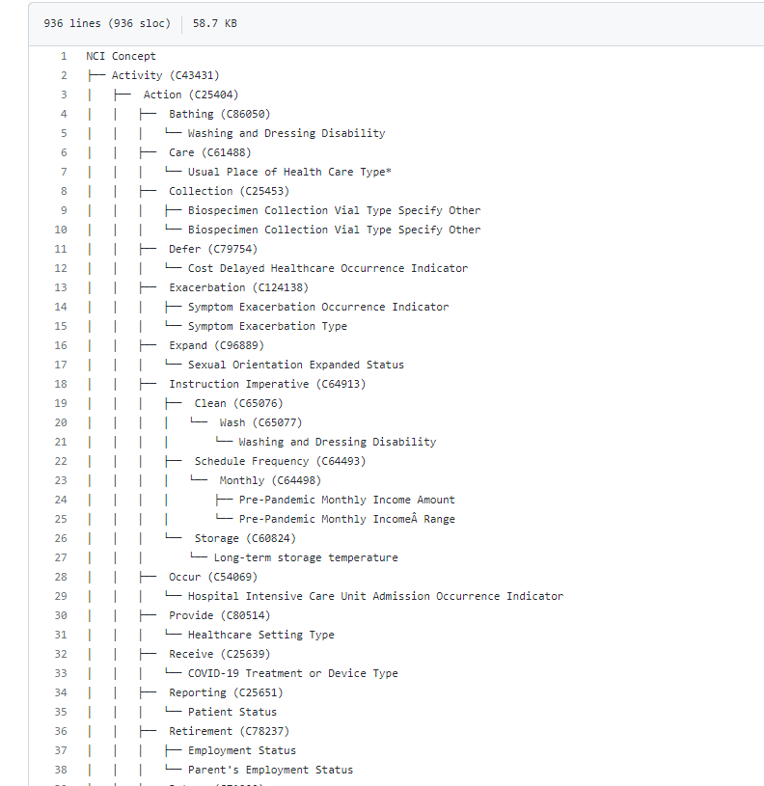
Process outline: aggregated NCIt concept tree for Project 5 COVID CDEs
Available on CBIIT GitHub
Project 5 COVID CDEs Aggregated Tree 2023-03-30.txt
Note:
NCIt concepts are branches and they have C codes in parenthesis.
CDEs are leaves in this tree and they do not have NCIt codes.
That is how one can differentiate one from another.
This tree shows where Project 5 COVID CDEs fall semantically in NCIt concept hierarchy.
NCIt concepts
CDE

Slide 17
Team Acknowledgements
NCI CBIIT:
Fed. Leads: Denise Warzel, Deborah Duran
Leidos TPM: Zhengwu Lu
Samvit Solutions:
Olga Vovk
Wendy Ver Hoef
Sofia Syed
Hastak Smita
BRICS team:
Fed. Lead: Matthew McAuliffe
Sapient: Kevin Armengol
NLM MetaMap: Francois Lang

